Slide 1
Predicting Revenue For The Coming Month (January), Exploring Data To Get Insights and Preparing a Predictive Model

Slide 2
Methodology
Looked for Null and Duplicate values and dropped null and duplicate values
Doing Time Series Prediction using Auto-ARIMA and Exponential Smoothening Algorithm
Doing Exploratory Data Analysis
Applying Random Forest, Gradient Boosting
Applying Stochastic Gradient Decent Regression and Checking Assumptions
Applying K-Means Clustering Technique to Cluster Consignors, profiling the clusters and applying SGDRegression
Applying Yeo-Johnson Power transformation and applying SGDRegression.

Slide 3
Time Series Modelling

Slide 4
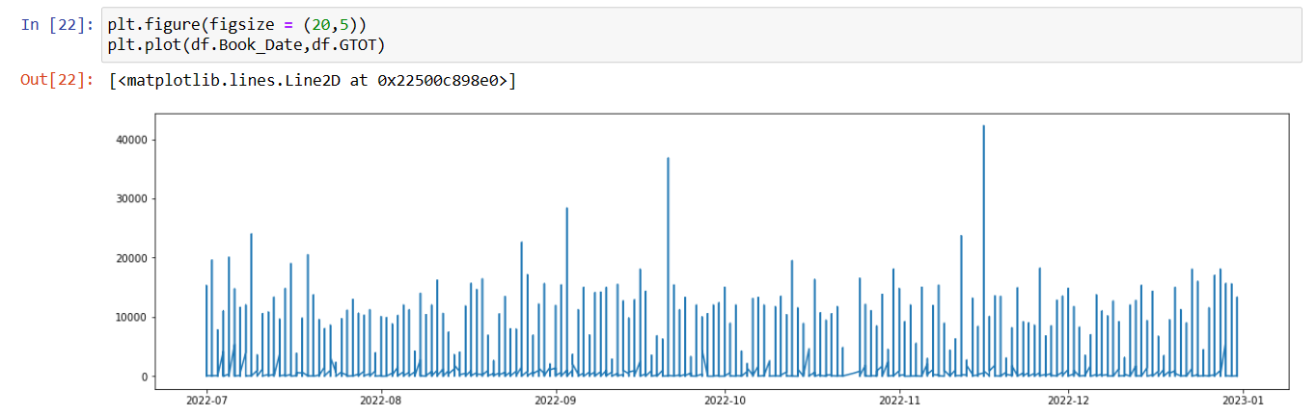

Slide 5
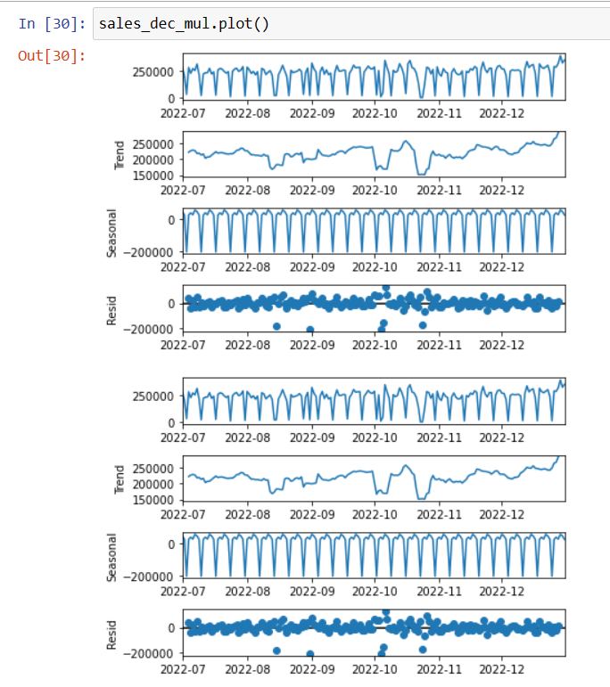
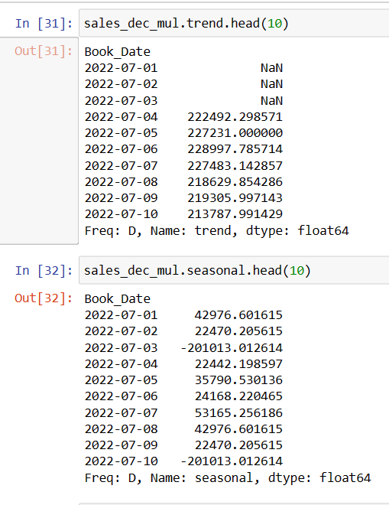

Slide 6
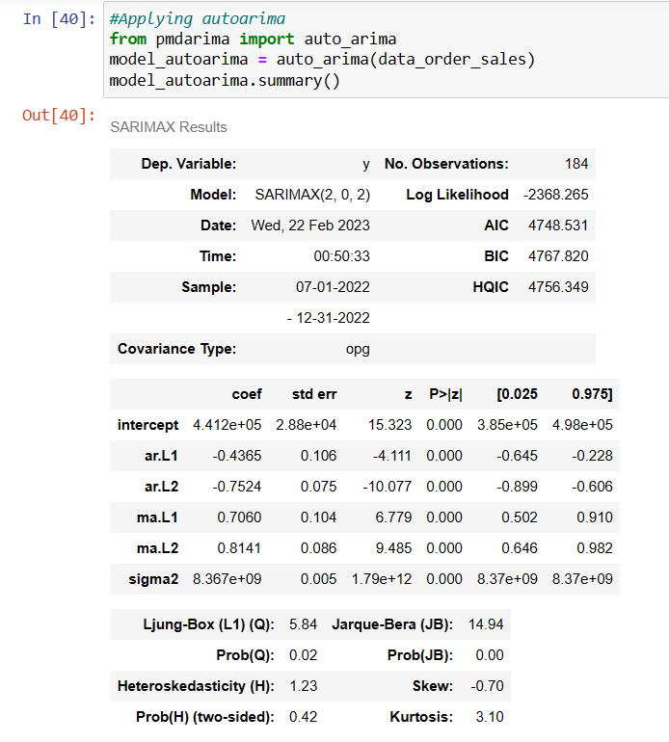
# From Jarque-Bera p-value we can say that residuals are not normally distributed. H Null: Data is normally distributed
# From Ljung-Box test we can say that there is presence auto-correlation. H Null: There is no auto-correlation.
# From Heteroskedasticity test we can say there is homoskedasticity. H Null: There is no heteroskedasticity

Slide 7
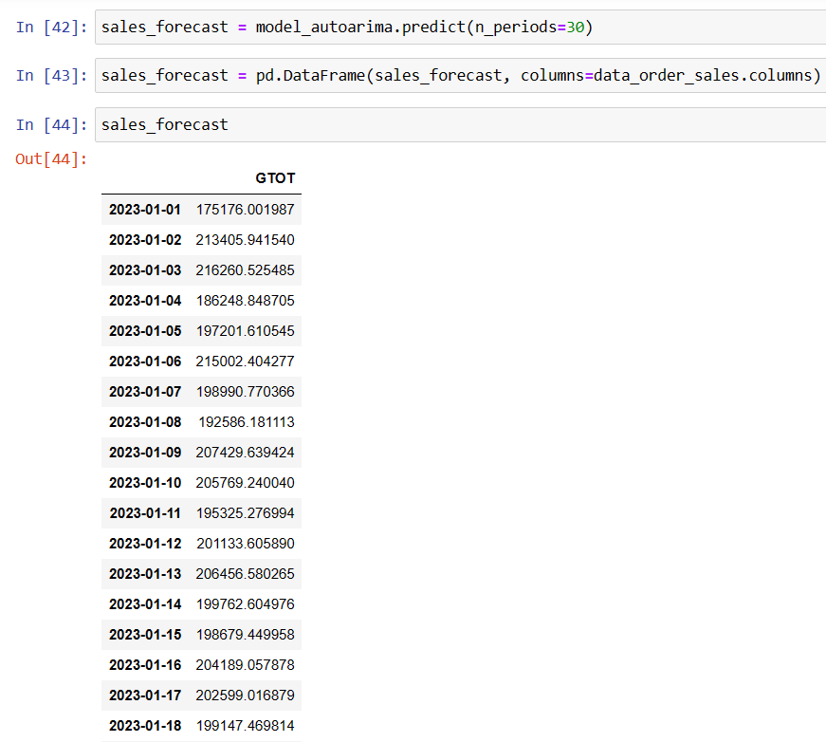

Slide 8
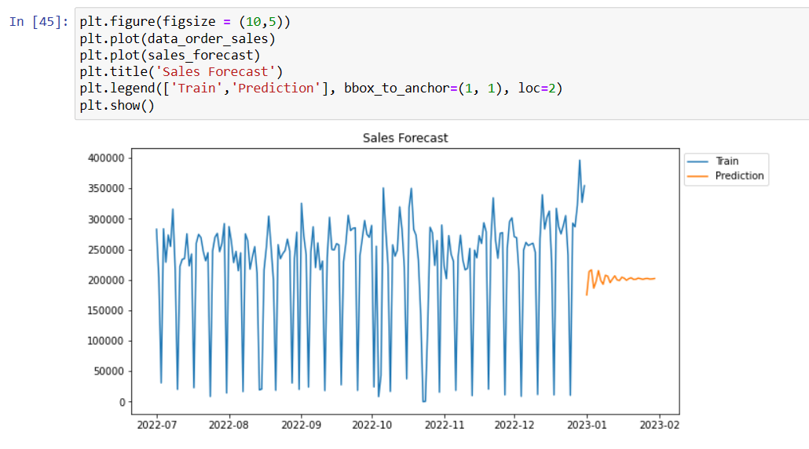

Slide 9
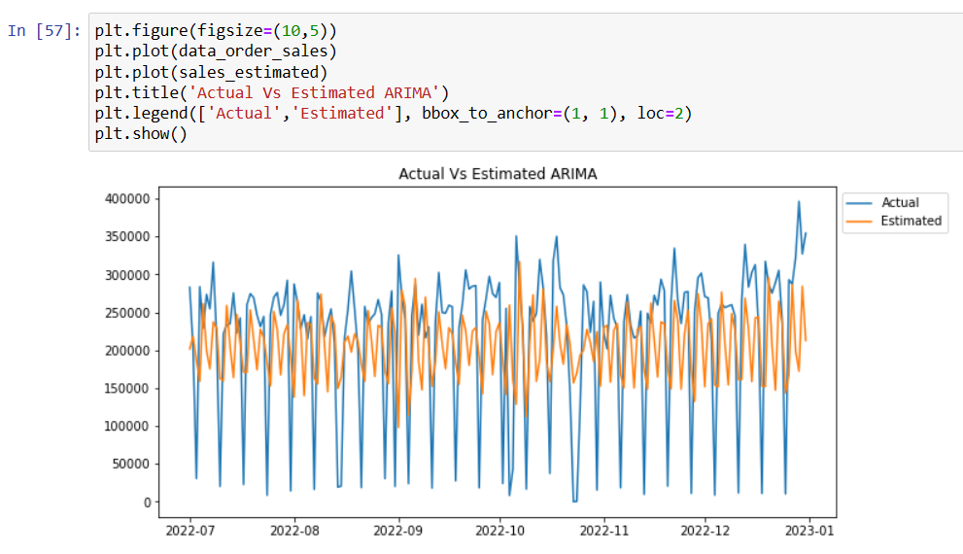
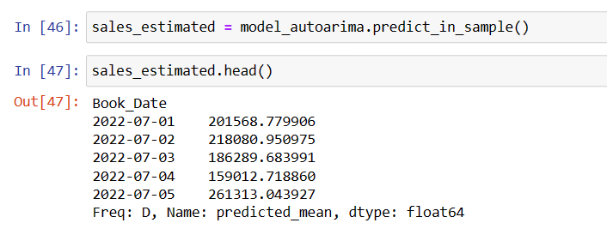

Slide 10
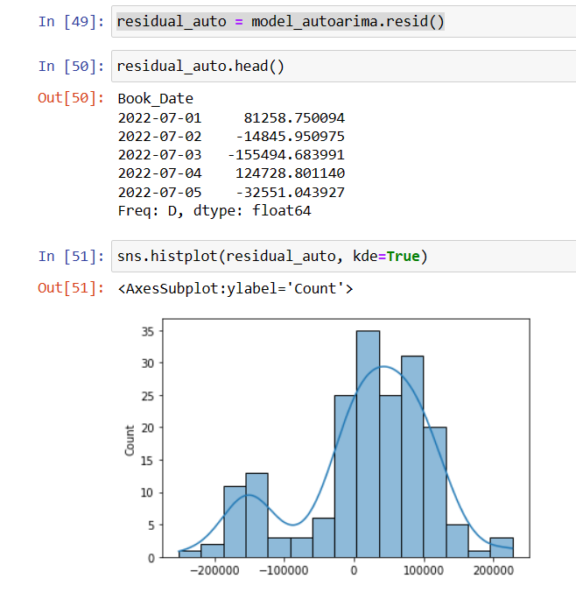
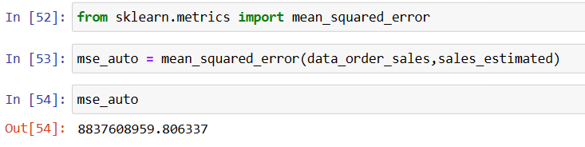

Slide 11
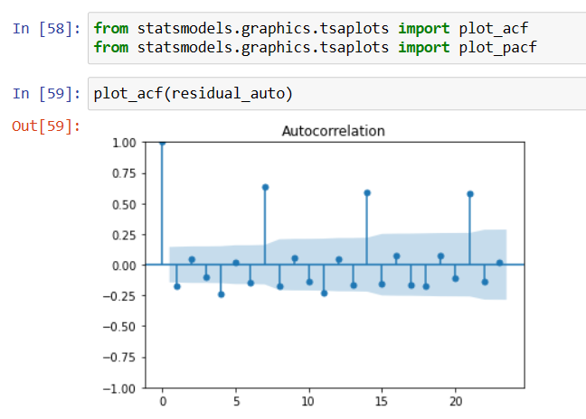
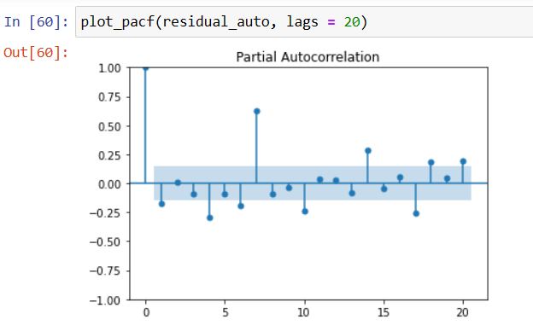

Slide 12
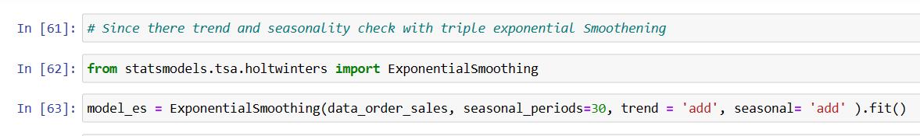
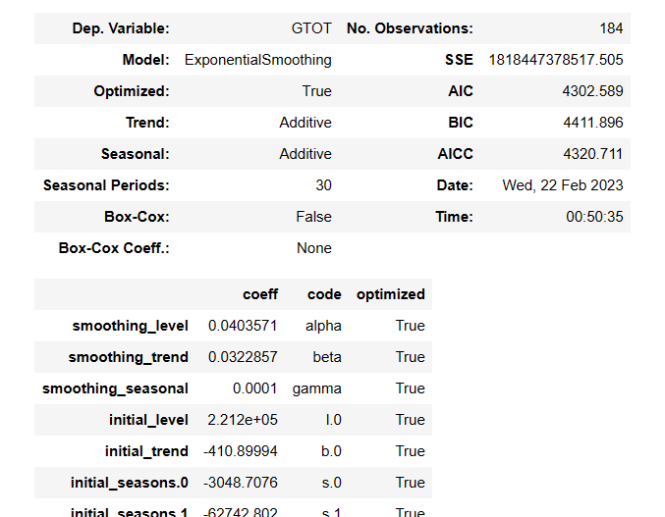

Slide 13
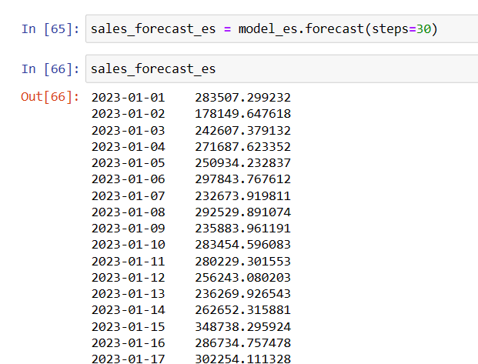

Slide 14
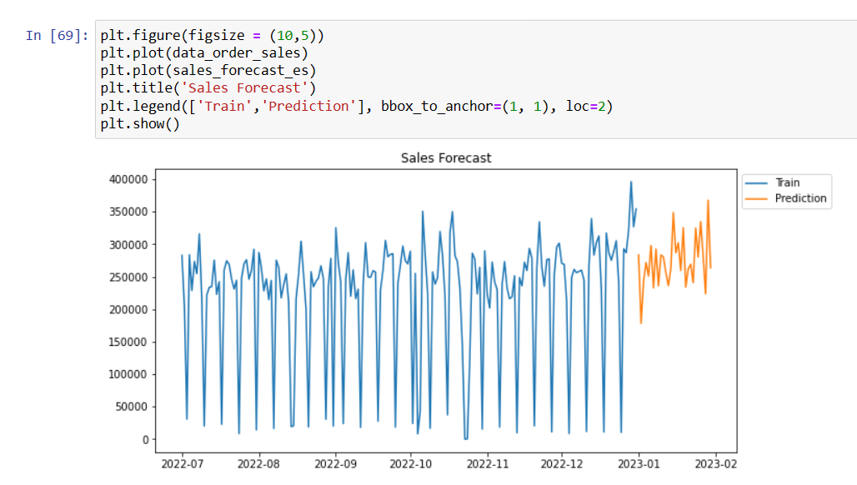

Slide 15
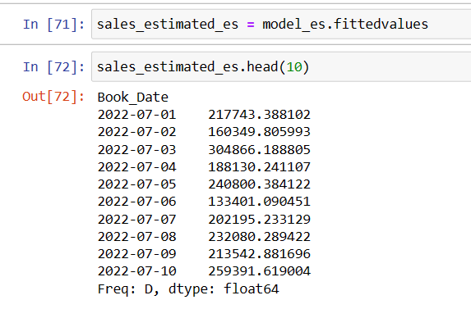

Slide 16
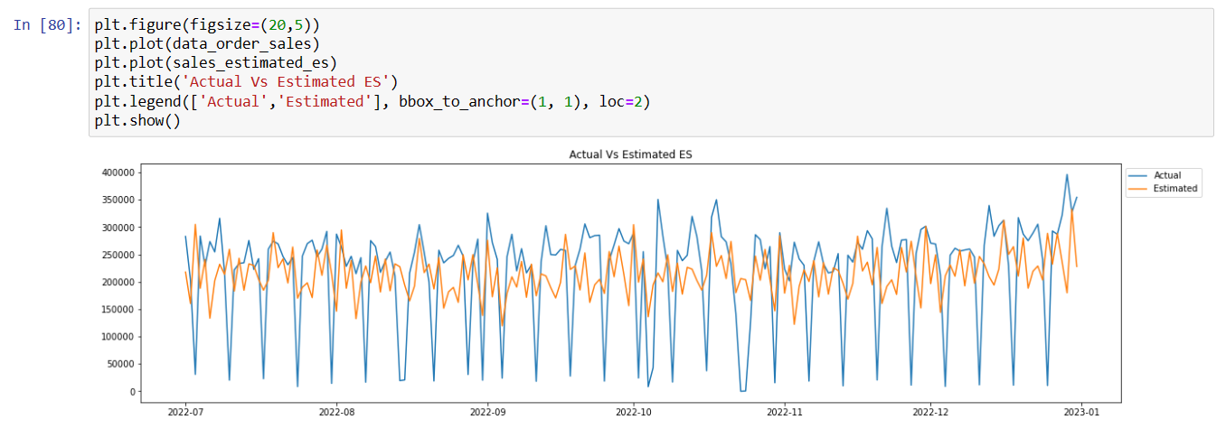

Slide 17
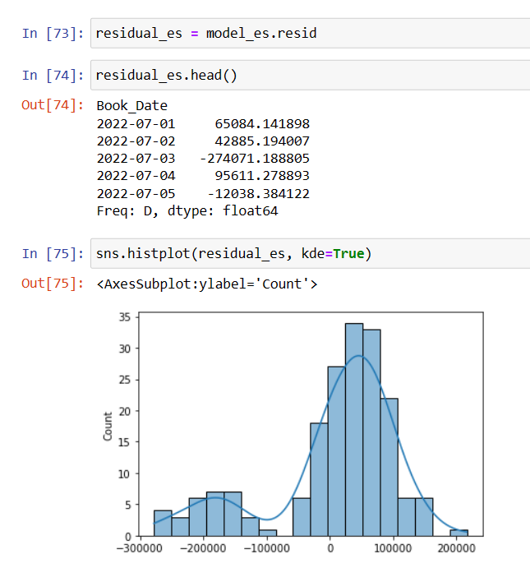
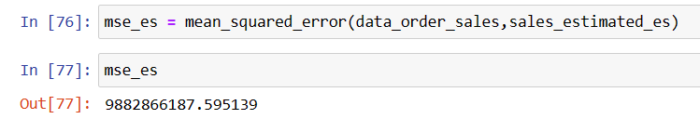

Slide 18
Exploratory Data Analysis

Slide 19
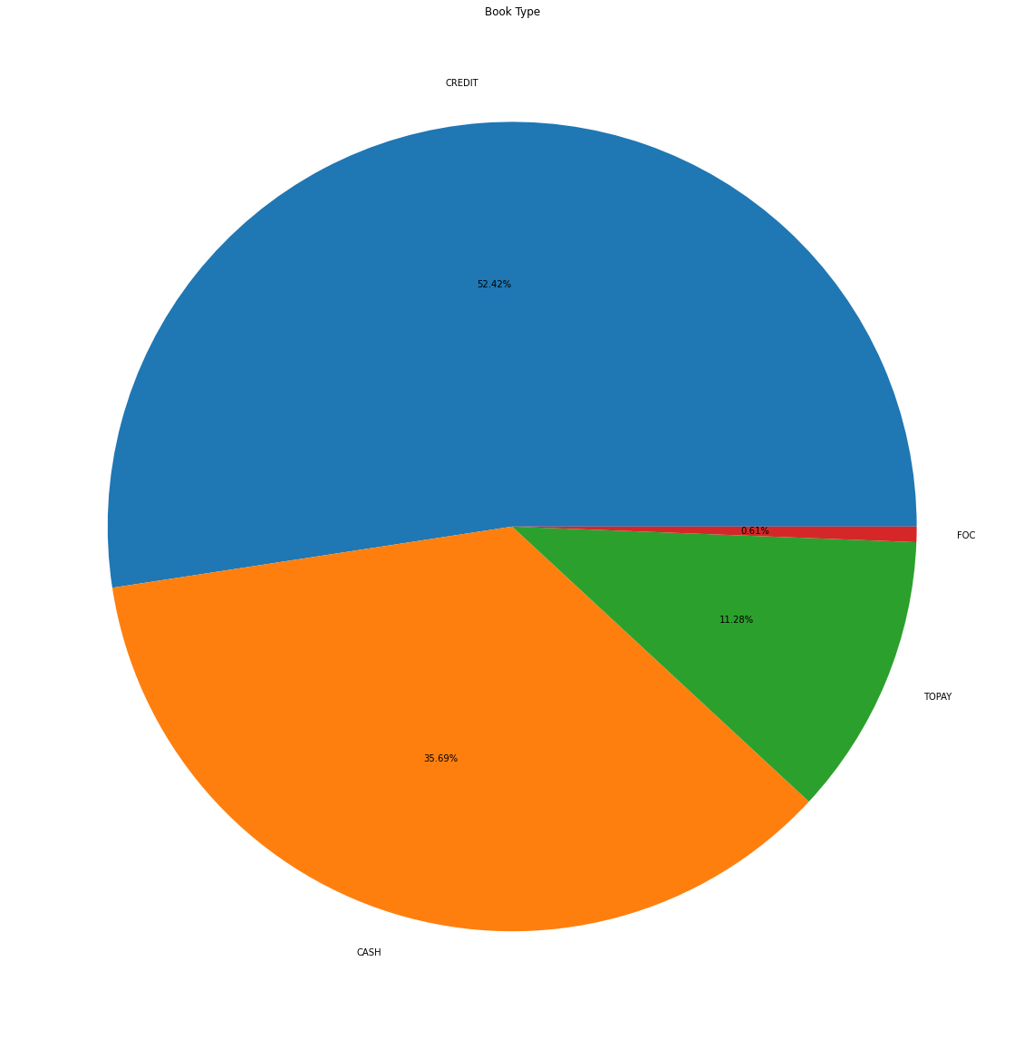

Slide 20
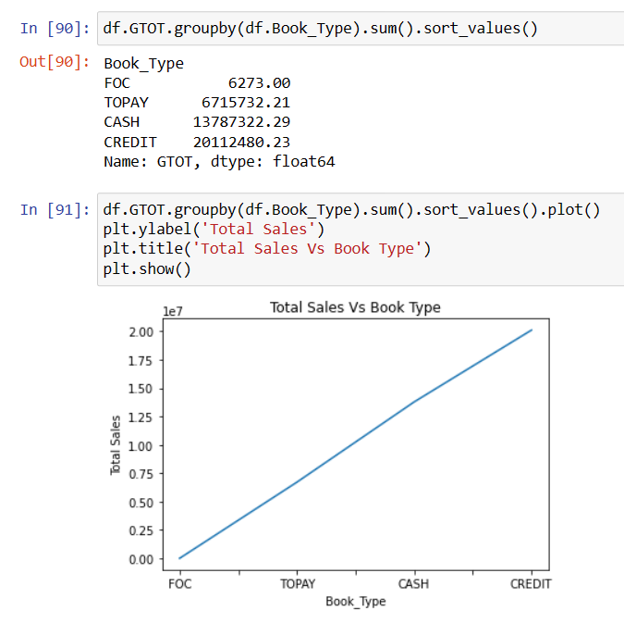
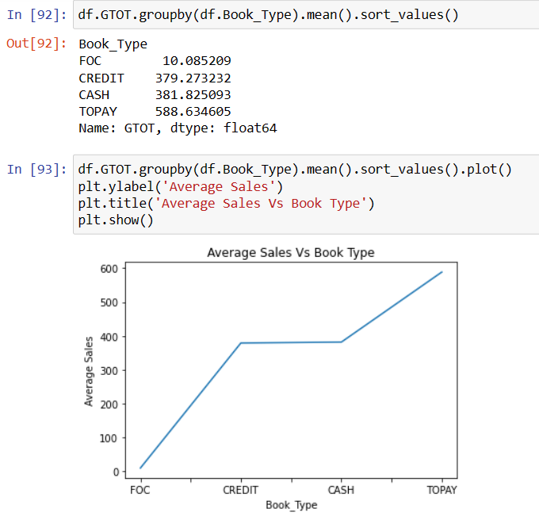

Slide 21
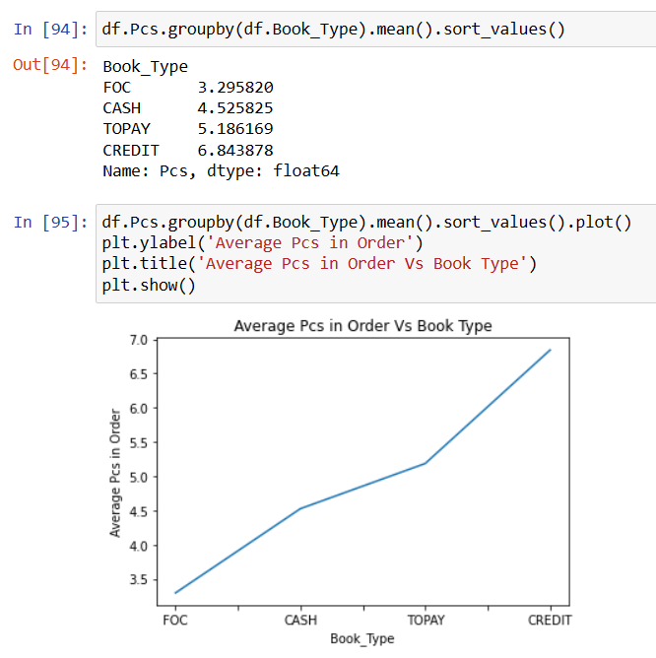
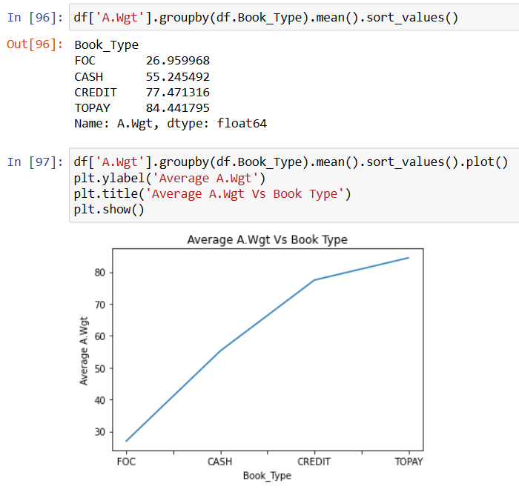

Slide 22
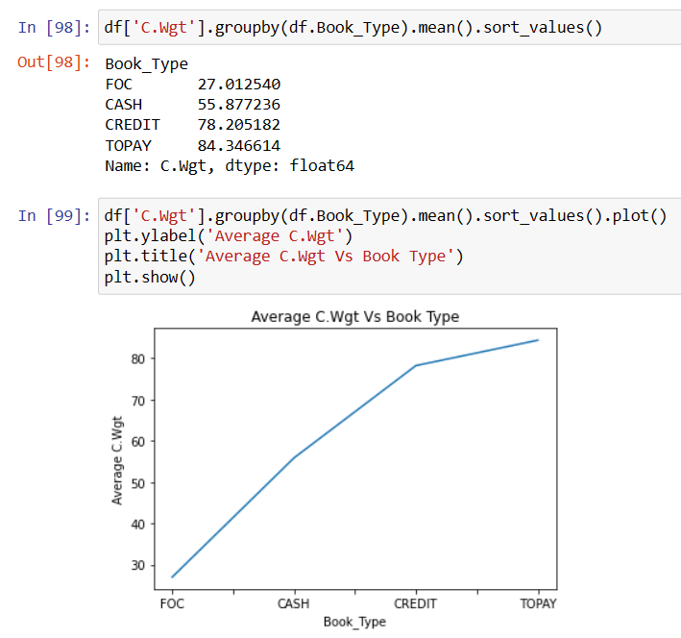
# From the above plots we can see credit is opted the customer whose on an average gives 7 peices in order followed by TOPAY with a average of 5 peices in order
# However we can see people who opt TOPAY have significantly higher A.Wgt and C.Wgt compared to Credit

Slide 23
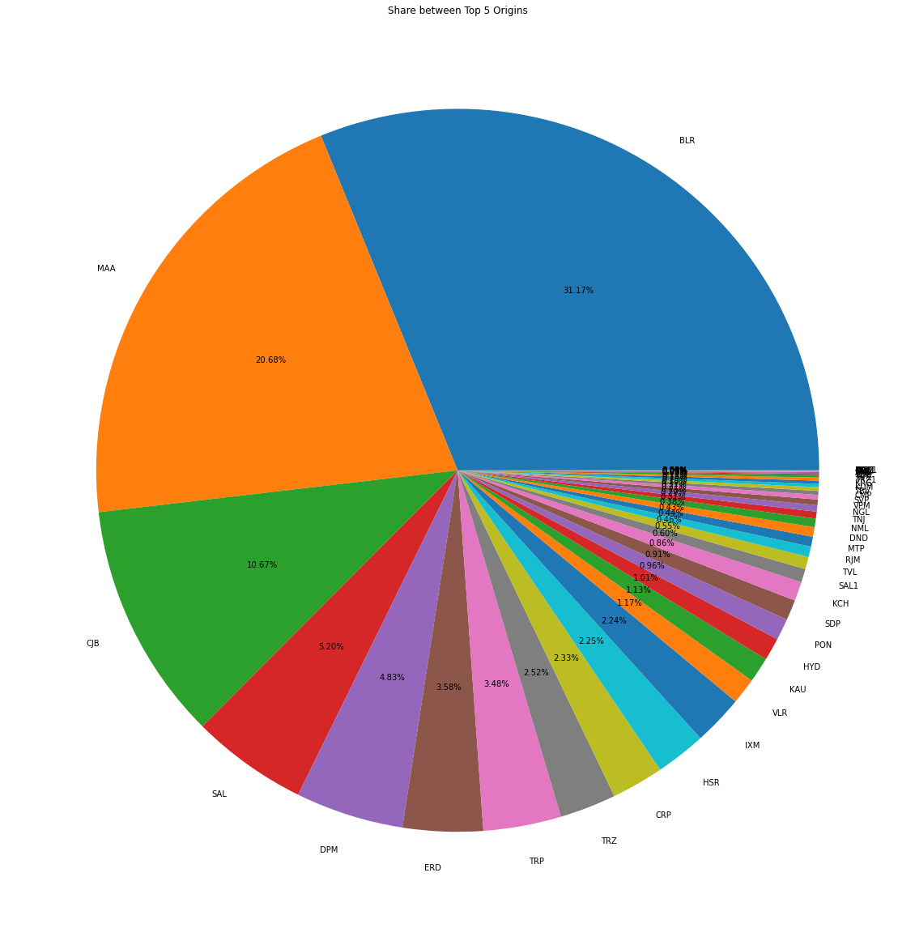

Slide 24
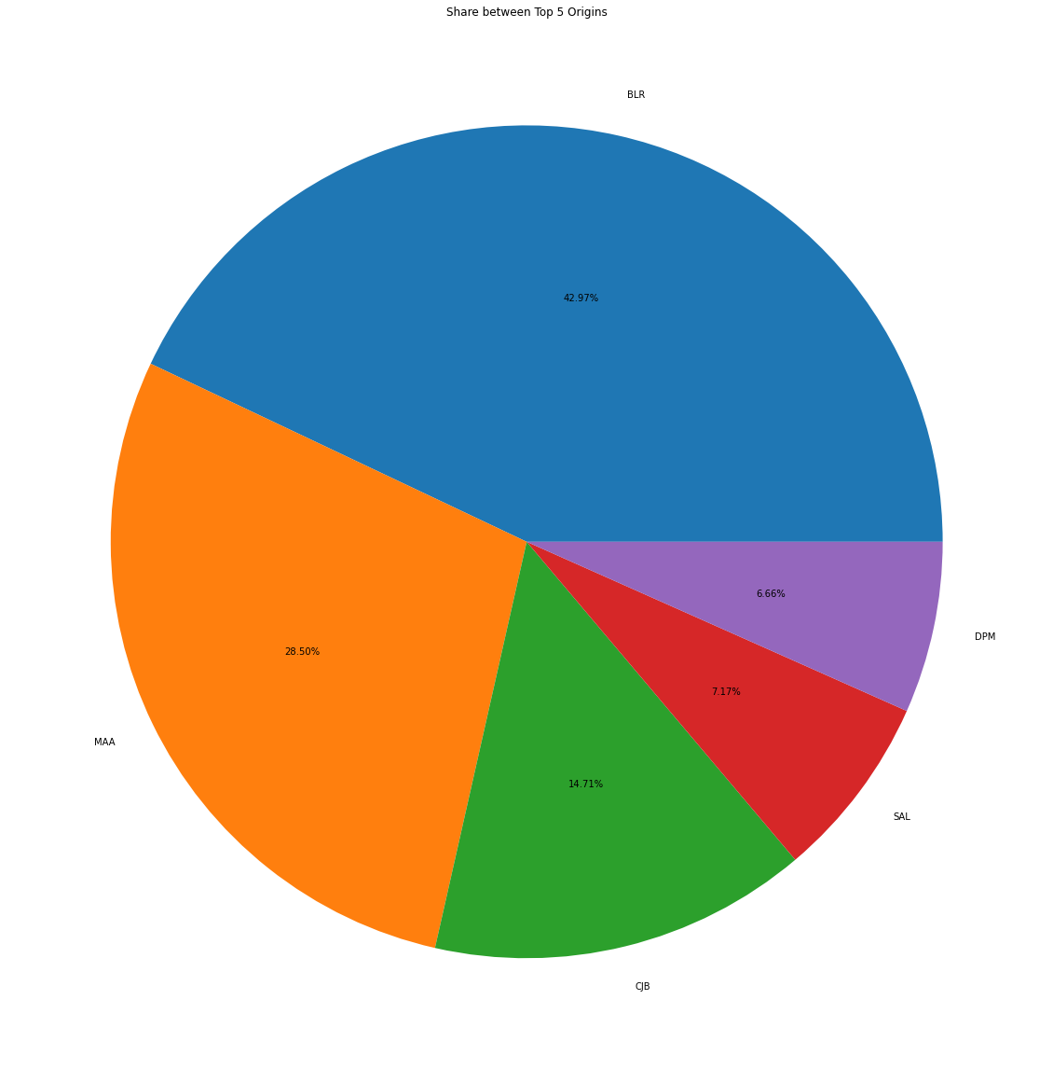

Slide 25
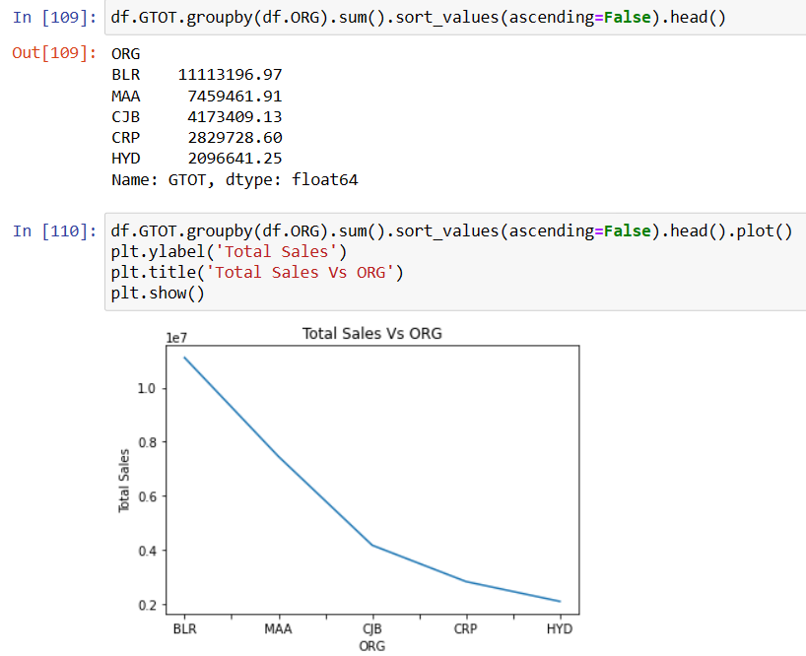
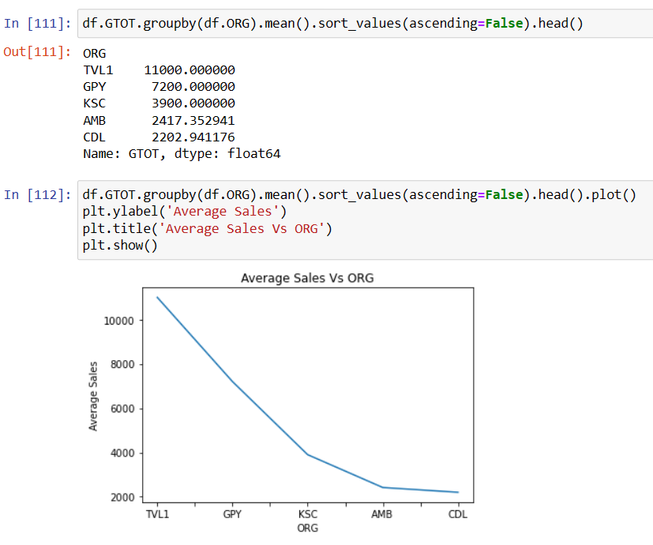
# No point here looking the average sale from destination as place which gives highest average sale doesn't contribute to total sales

Slide 26
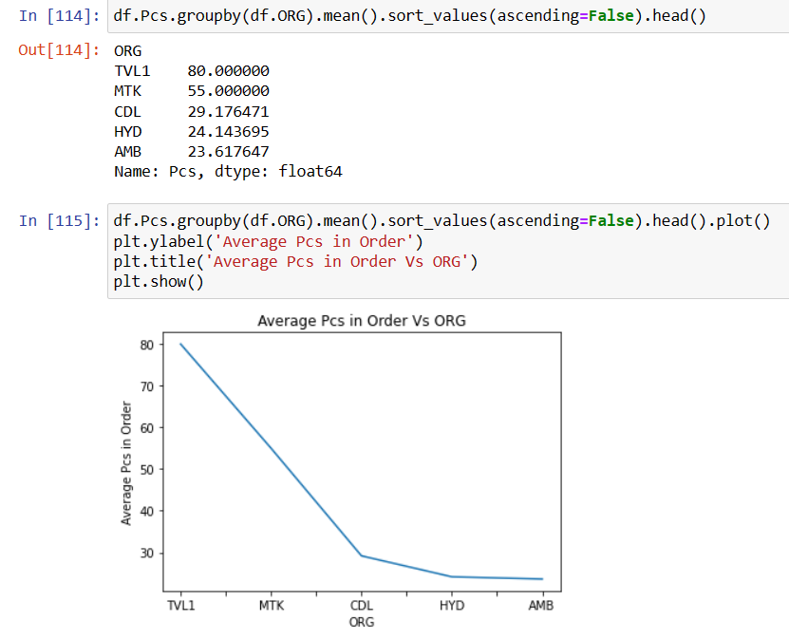
# No point here looking the average pcs from destination as it doesn't contribute to total sales
# Hyd represents in top 5 sales contributor also in top 5 pcs wise contributor

Slide 27
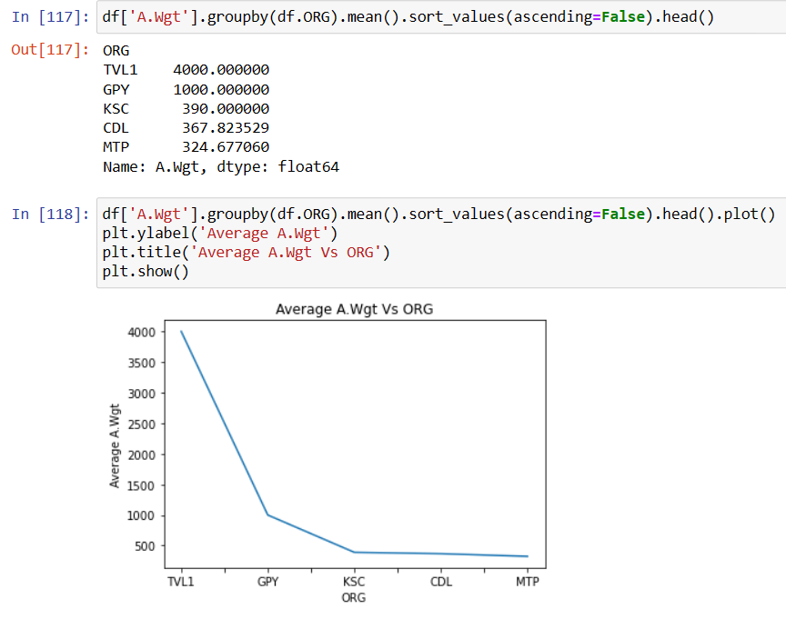
# No point here looking the average wgt from destination as it doesn't contribute to total sales

Slide 28
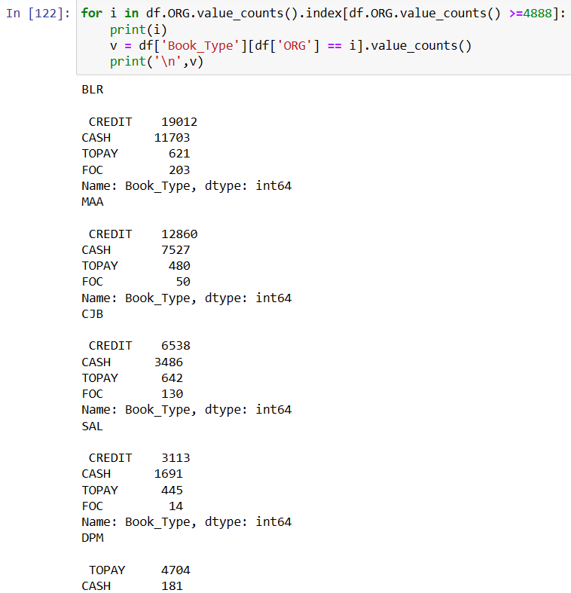
# All the top five origins prefers Credit excapt DPM

Slide 29
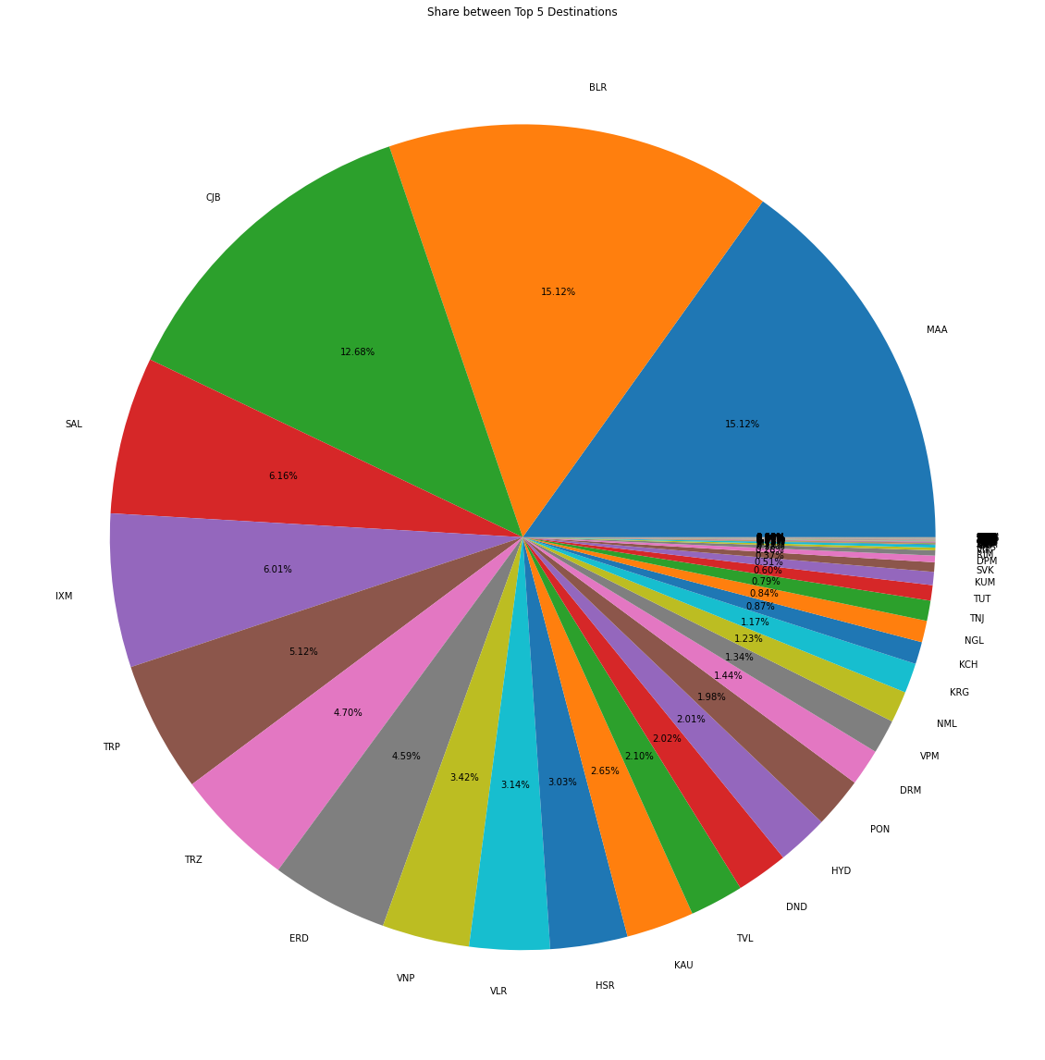

Slide 30
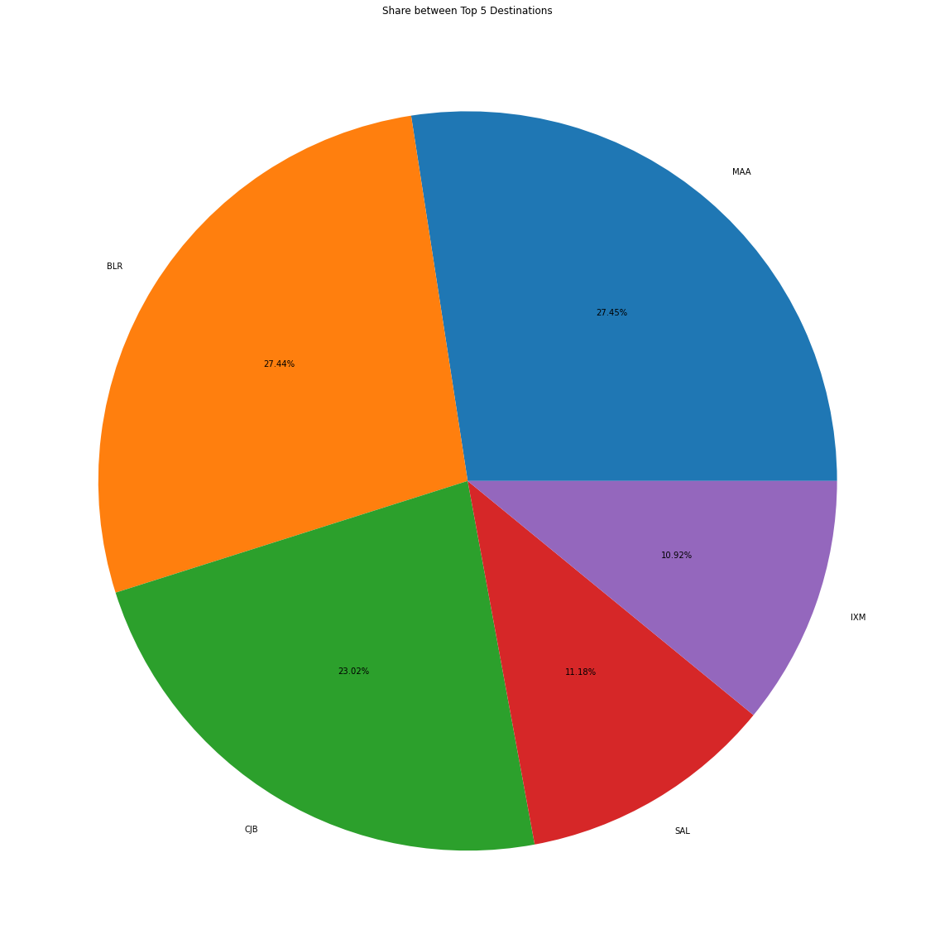

Slide 31
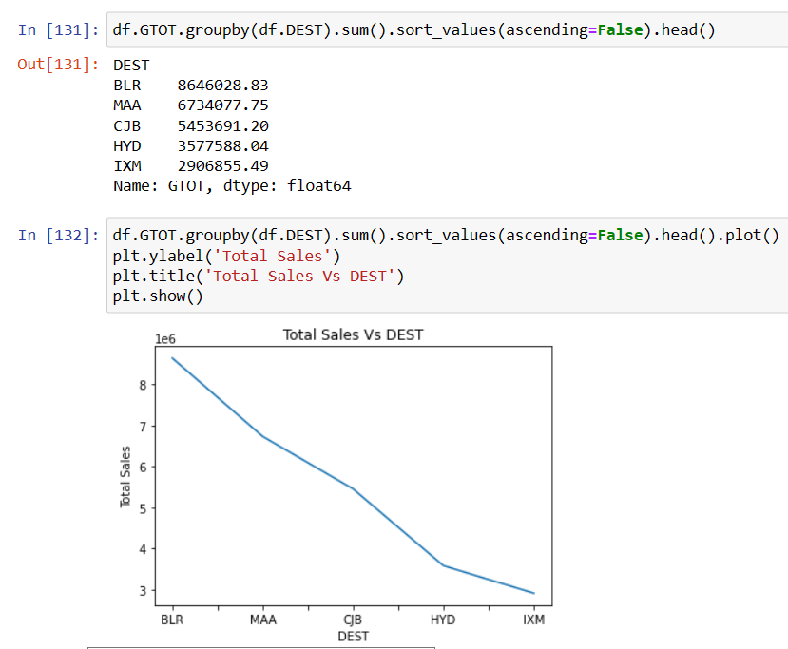

# Highest Avg. ticket size doesn't depending on destination doesn't contribute to total sales

Slide 32
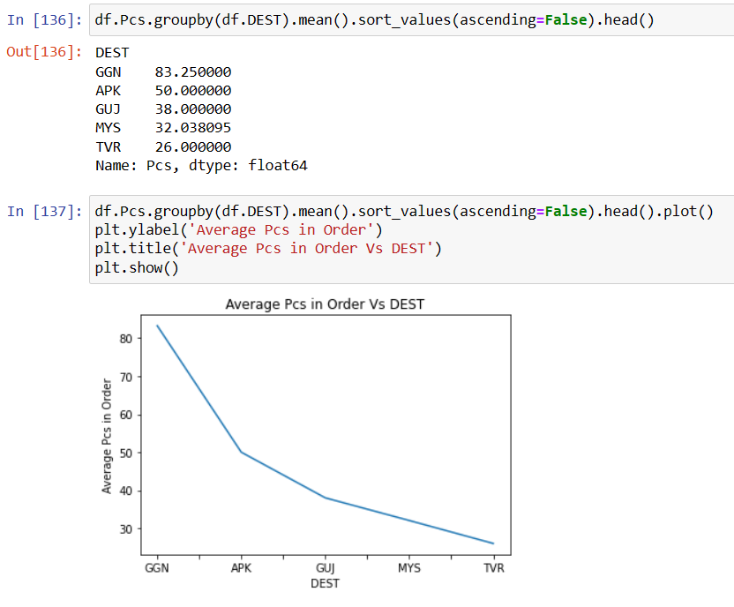
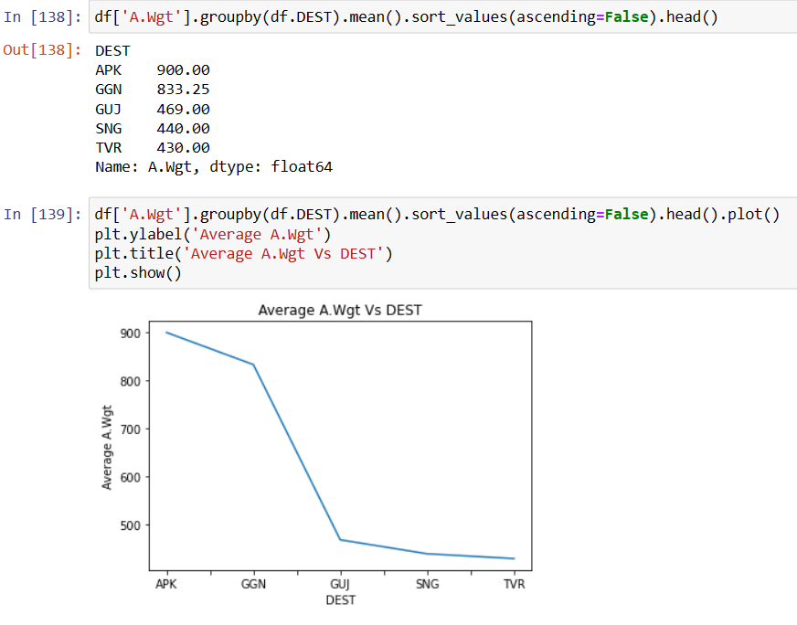

Slide 33
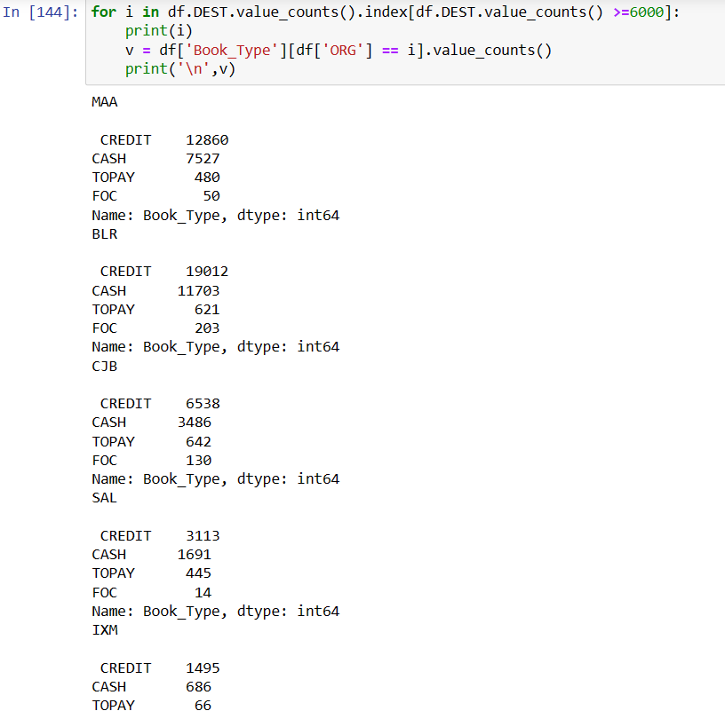
# Credit is the favorite option across all Top 5 Cities

Slide 34
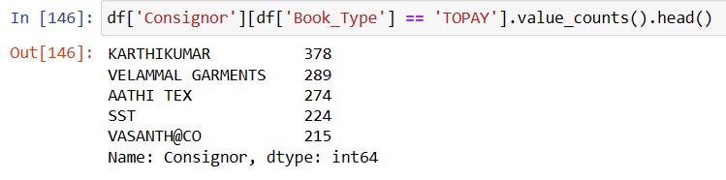
# From above data we can clearly see contribution by Customer opting for TOPAY is significantly less towards total sales but their
# ticket size is high. These group of customers if focussed and can bring significant difference in revenue

Slide 35
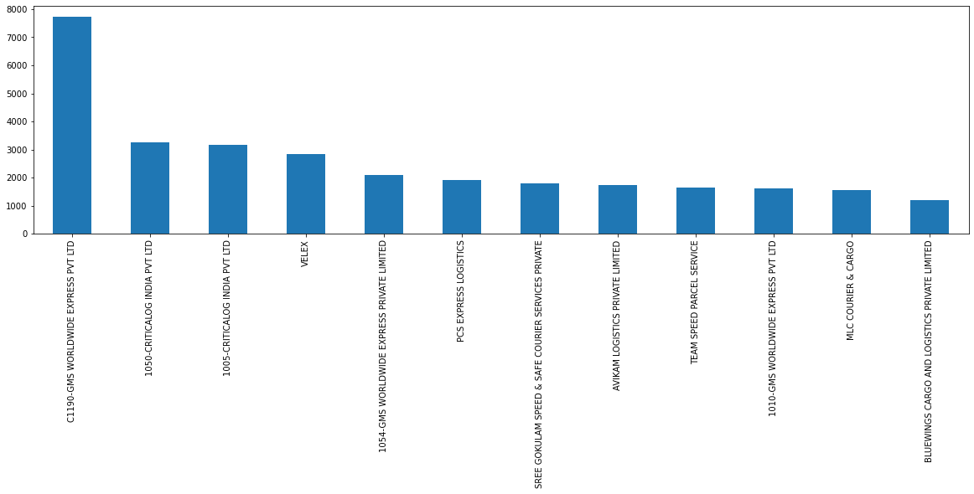
Top Consignors
# Considering 1200 orders in 6 months, which means 200 orders a month

Slide 36
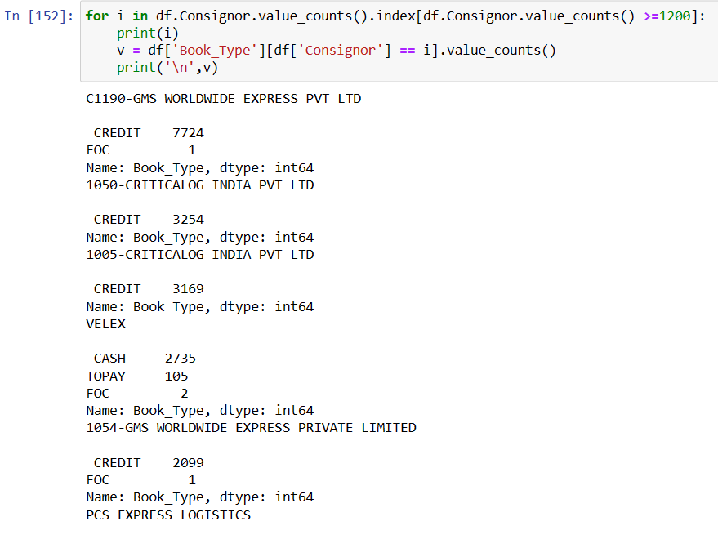

Slide 37
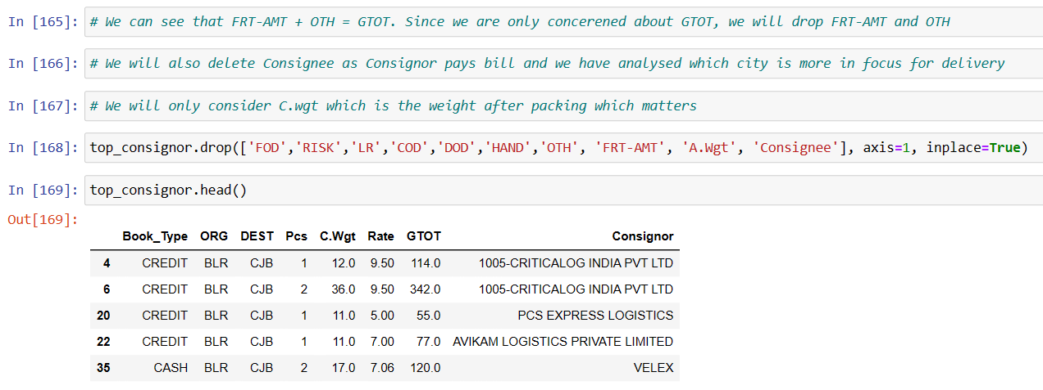

Slide 38
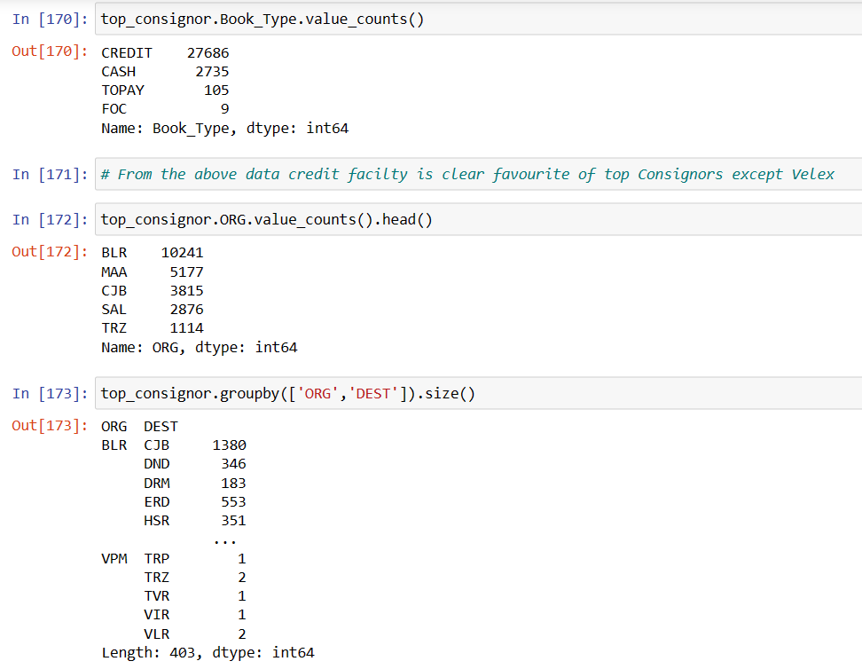

Slide 39
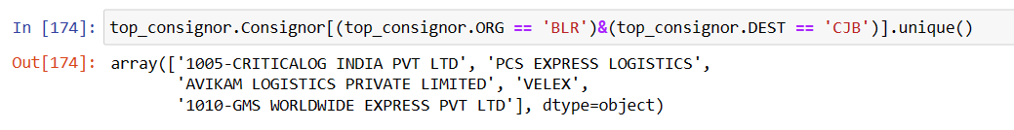
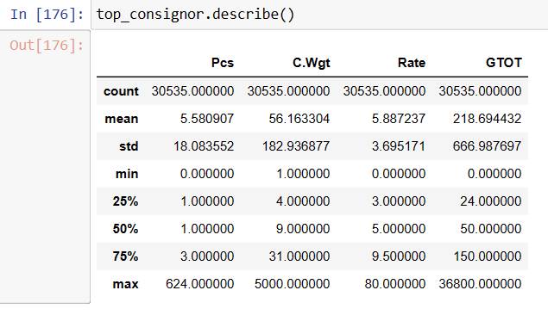
# Highest number of Consignments are going from Bangalore To Coimbatore. Though this route has highest traffic, it is not significant
# because it contributes less than 5% of the total number of consignments.

Slide 40
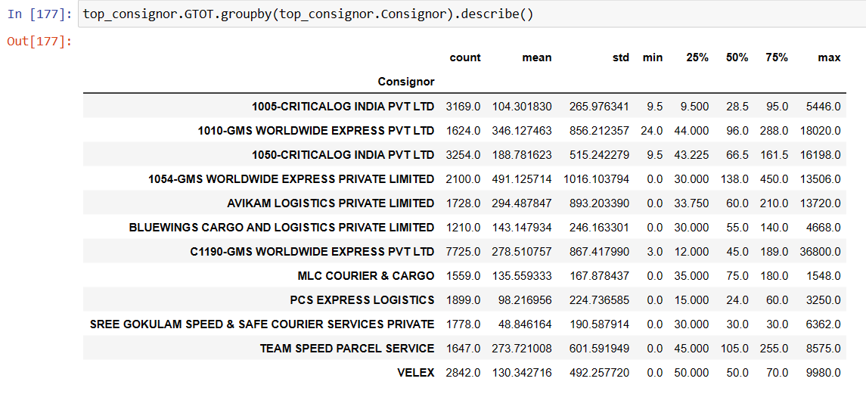

Slide 41
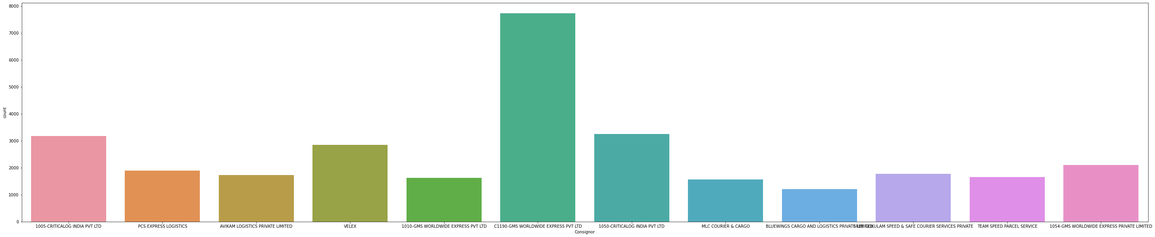
Countplot of Consignors

Slide 42
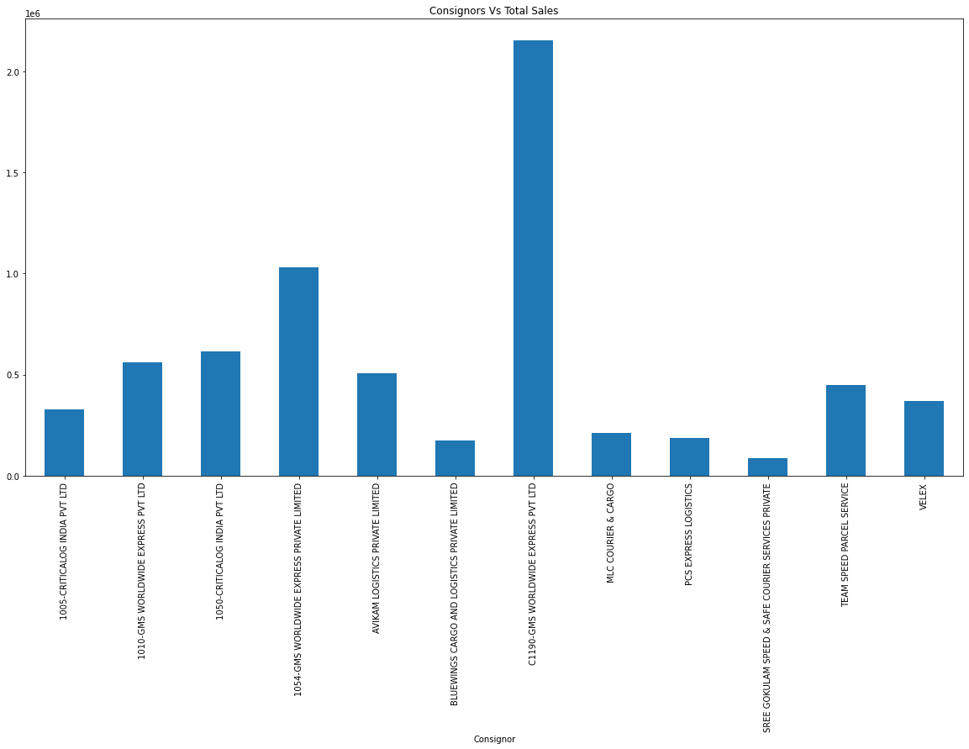

Slide 43
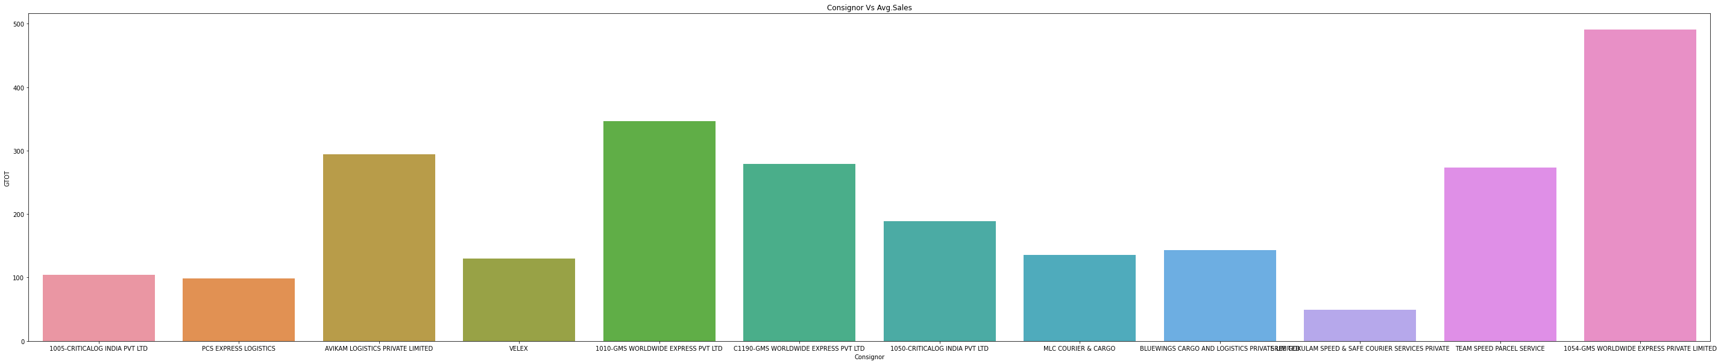

Slide 44



Slide 45



Slide 46


Slide 47


Slide 48


Slide 49


Slide 50


Slide 51


Slide 52


Slide 53







Slide 54




Slide 55


Slide 56


Slide 57
Models

Slide 58


Slide 59


Slide 60



Slide 61


Slide 62


Slide 63




Slide 64


Slide 65


Slide 66




Slide 67

Using Clusters in place of Consignors

Slide 68


Slide 69


Slide 71
Business Implication
This project will to predict the business for the month of January.
This project has a model with can explain 96% variance in revenue which can be explained by the given predictors.
They use this model in to predict revenue with high accuracy.

